Slide 1
COLLEGE MANAGEMENT SYSTEM
Name: Prachi Navik
Roll.no: 33
Sem: 5
Div: A
Name: Dhruvi Patel
Roll.no: 44
Sem: 5
Div: A

Slide 2
INTRODUCTION:
The title of the project is “COLLEGE MANAGEMENT SYSTEM”
The system is an Intranet based application that aims at providing information to all the levels of management within an organization and other student. This system can be used as a information management system for the college and other student. For a given student/staff (Technical / Non-technical) the Administrator creates login id & password, using these student/ staff (Technical / Non-technical) can access the system to either upload or download some information from the database
This project is aimed at developing College Management System that is of importance to either an educational institution or a college. The system is an Intranet based application that can be accessed throughout the institution or a any department. This system is being developed for a college to maintain and facilitate easy access to information. For this the users need to be registered with the system after which they can access or modify data as per the permissions given to them.

Slide 3
OBJECTIVES
This is a web-oriented application allows us to access the whole information about the college, staffs, students, facilities etc. This application provides a virtual tour of Campus. Here we will get the latest information about the students and staffs. This generic application designed for assisting the students at an institute regarding information on the courses, subjects, classes, assignments, etc. It also provides support that a faculty can also check about his assignments, can upload assignments, and notices to the students. Here administrator will manage the accounts of the student and faculties, makes the accounts.

Slide 4
TOOL AND TECHNOLOGIES
HTML
CSS
BOOTSTRAP
JAVASCRIPT
PHP
JSON
jquery

Slide 5
USER-WISE FUNCTIONALITIES
Admin
Database management
Admin profil
User profile management
Permissions
Website update
Login
Logout

Slide 6
USER-WISE FUNCTIONALITIES
Student
Student profile
View projects
Faculty list
Add project
Login
Logout

Slide 7
USER-WISE FUNCTIONALITIES
Faculty
Faculty profile
Student details
Projects
Login
Logout

Slide 8
USER-WISE FUNCTIONALITIES
Guest
College tour
Admission portal

Slide 9
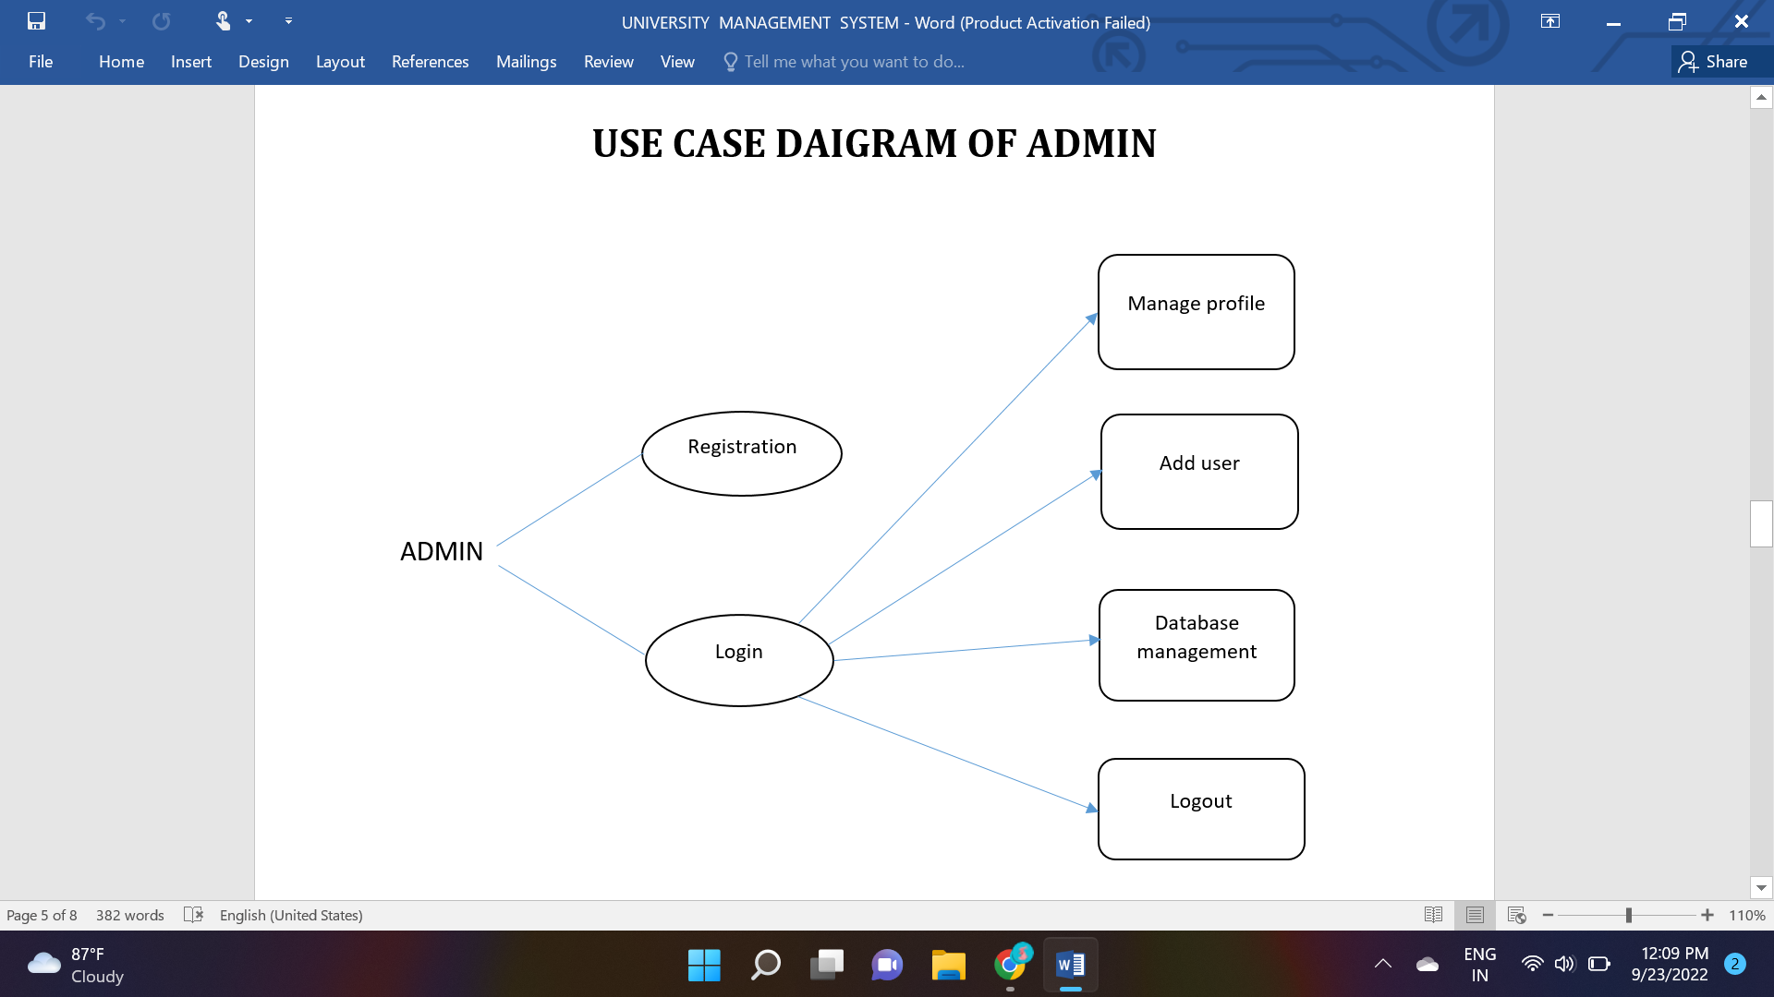

Slide 10
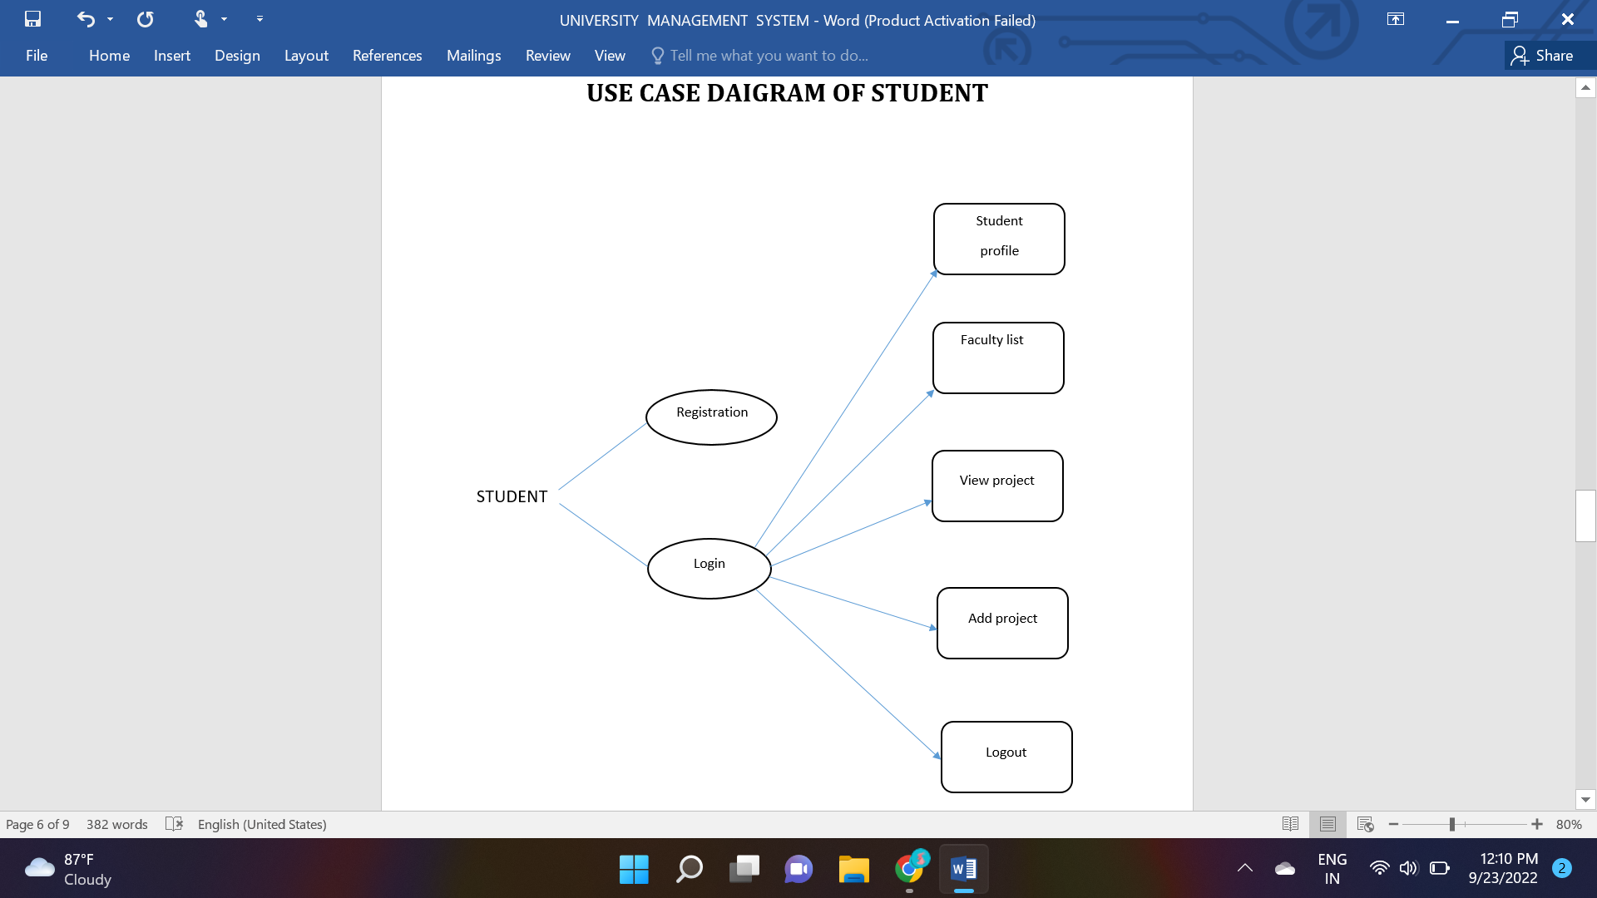

Slide 11
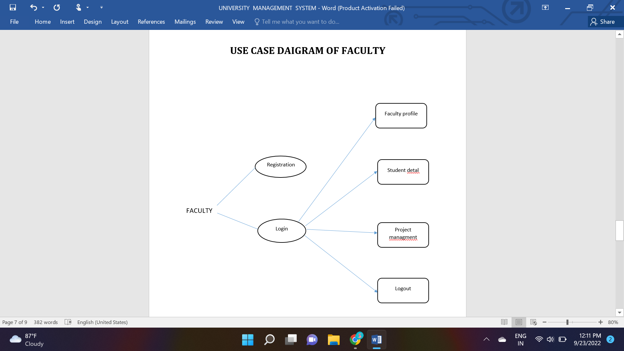

Slide 12
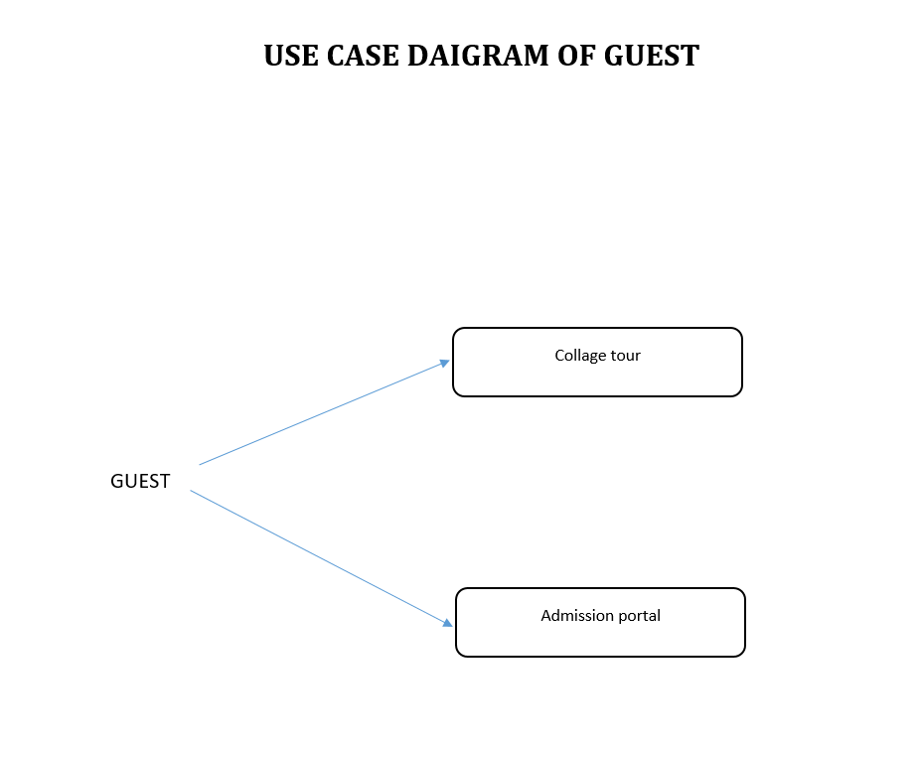

Slide 13
DATABASE
Projuser:
Project:
# | Name | Type | Null
1 | user_id | Int(10)
2 | user_name | Varchar(50)
3 | password | Varchar(8)
4 | User_roll_number | Int(10)
5 | phone_number | Int(10)
6 | email | Varchar(30)
7 | user_year | Int(4)
8 | last_login | tmestamp
9 | user_address | Varchar(100)
10 | user_department | Varchar(50)
11 | user_type | Varchar(50)
# | Name | Type | Null
1 | user_id | Int(20)
2 | user_id | Int(30)
3 | Project_title | Varchar(50)
4 | Projrct_type | Varchsr(50)
5 | Project_allocation | date
6 | Project_status | Varchar(50)
7 | Project_statusdate | date
8 | Project_supervisor | Varchar(50)
9 | User_name | Varchar(50)
10 | Project_department | Varchar(50)
11 | Project_requirements | Varchar(100)
12 | Project_objective | Varchar(100)
13 | Project_background | Varchar(100)
14 | Project_file_path | Varchar(200)
15 | view | Varchar(50)
16 | allow | Varchar(50)
17 | reject | Varchar(50)

Slide 14
DATABASE
ProjectStatusmap:
Projecttypemap:
# | Name | Type | Null
1 | id | Int(50)
2 | project_status | Varchar(50)
3 | project_status_type | Varchar(50)
# | Name | Type | Null
1 | id | Int(50)
2 | Project_criteria_name | Varchar(50)
3 | Project_type | Varchar(50)

Slide 15
DATABASE
Registration:
# | Name | Type | Null
1 | name | Varchar(50)
2 | email | Varchar(50)
3 | pin | Int(10)
4 | course | Varchar(50)
5 | state | Varchar(50)
6 | city | Varchar(50)
7 | addrese | Varchar(50)
8 | contsct | Int(10)

Slide 16

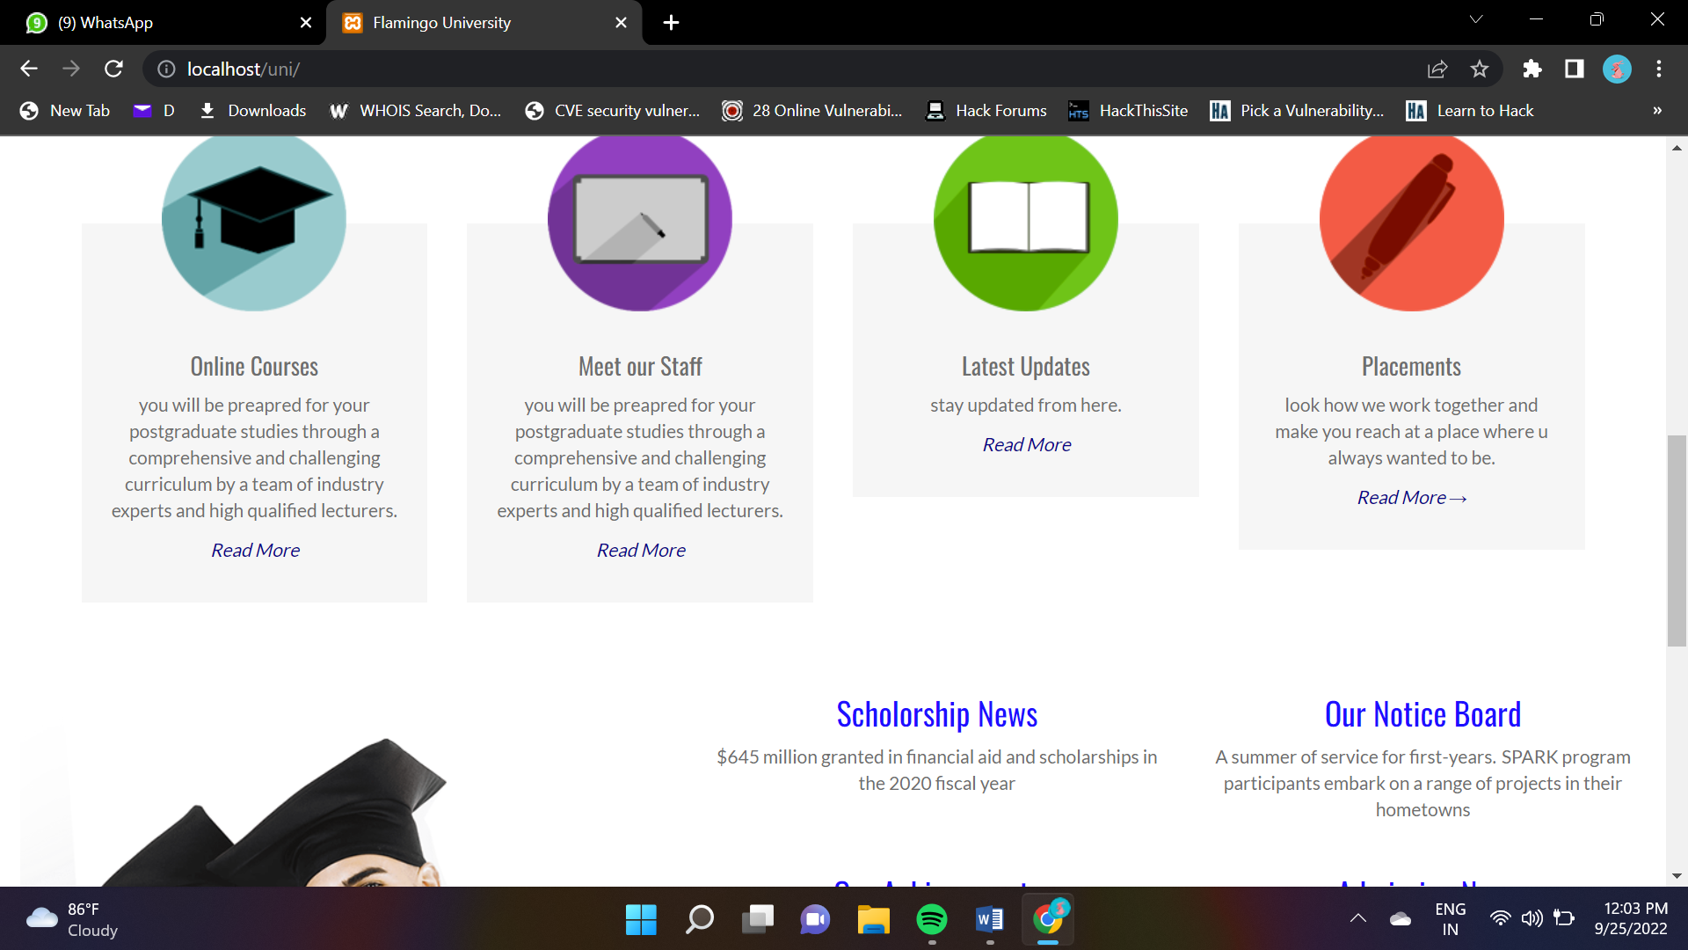
SCREENSHOTS

Slide 17
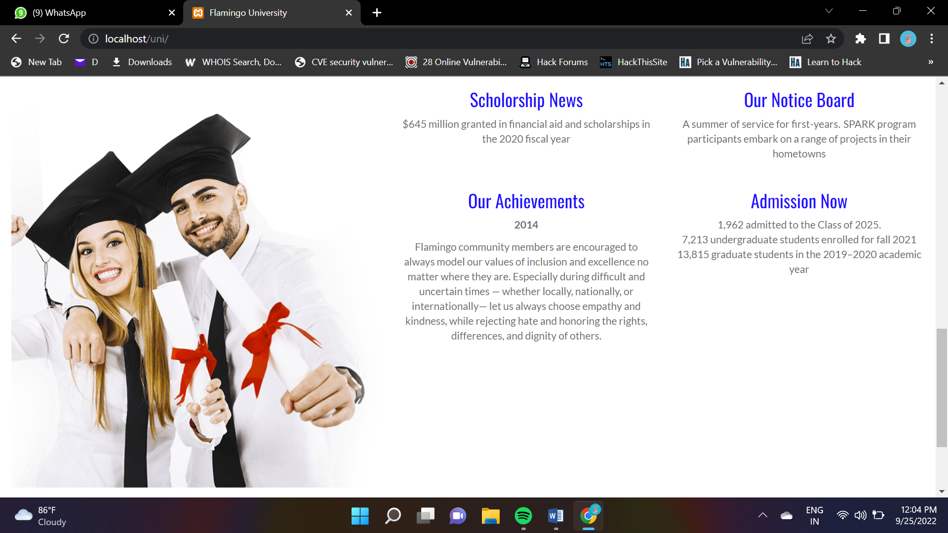
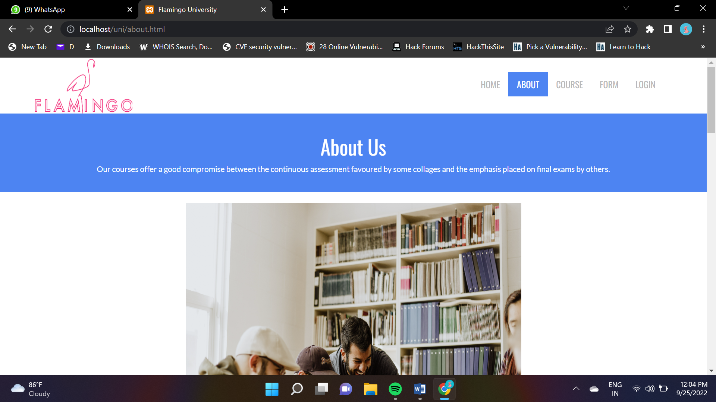
SCREENSHOTS

Slide 18
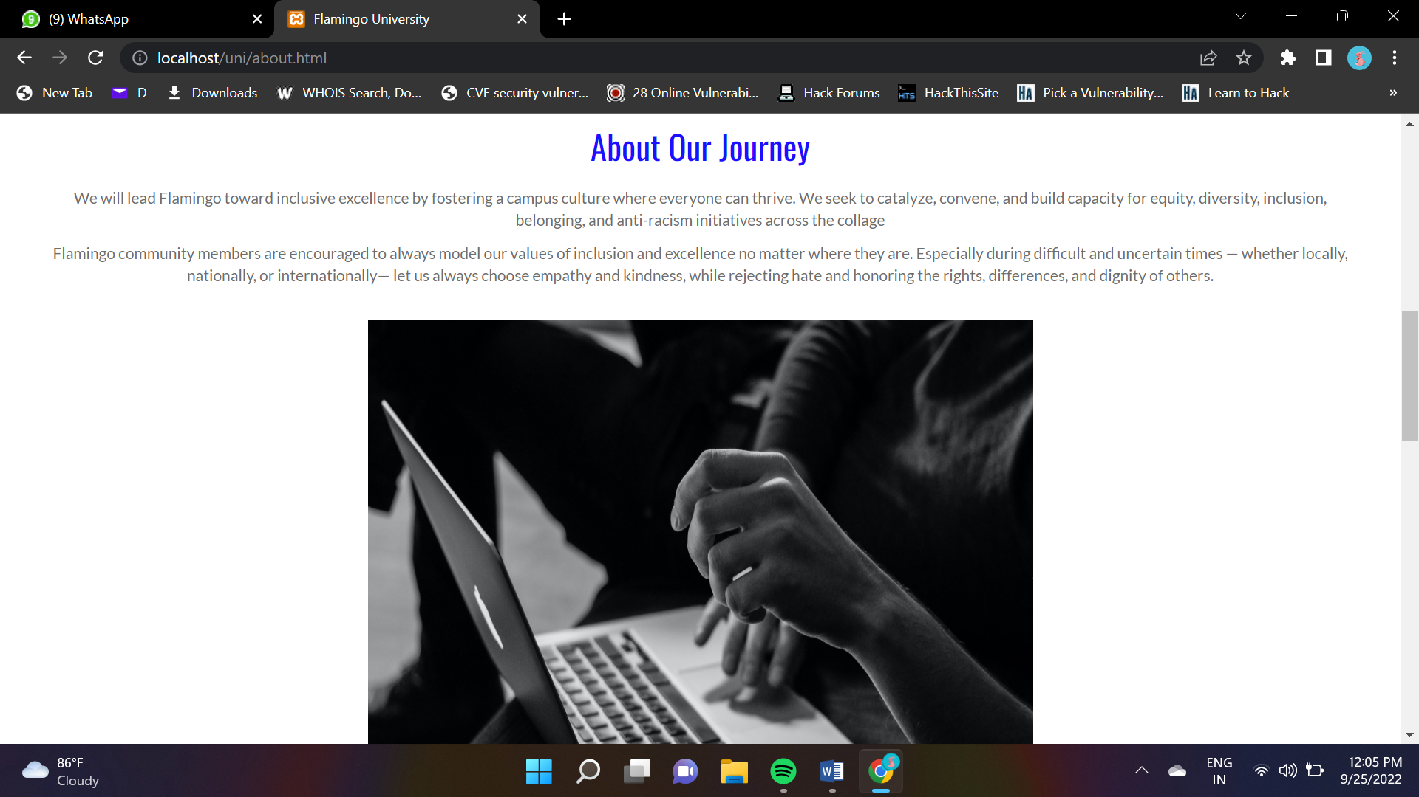
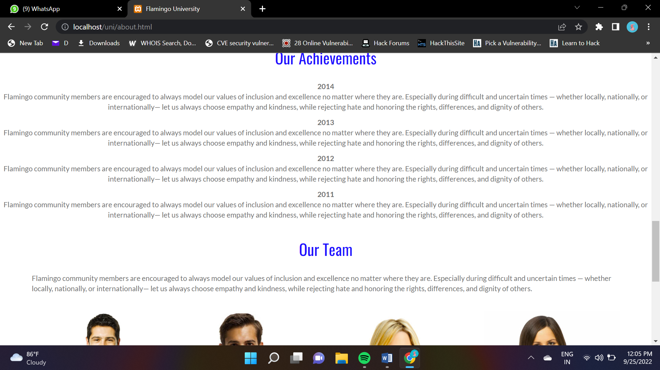
SCREENSHOTS

Slide 19
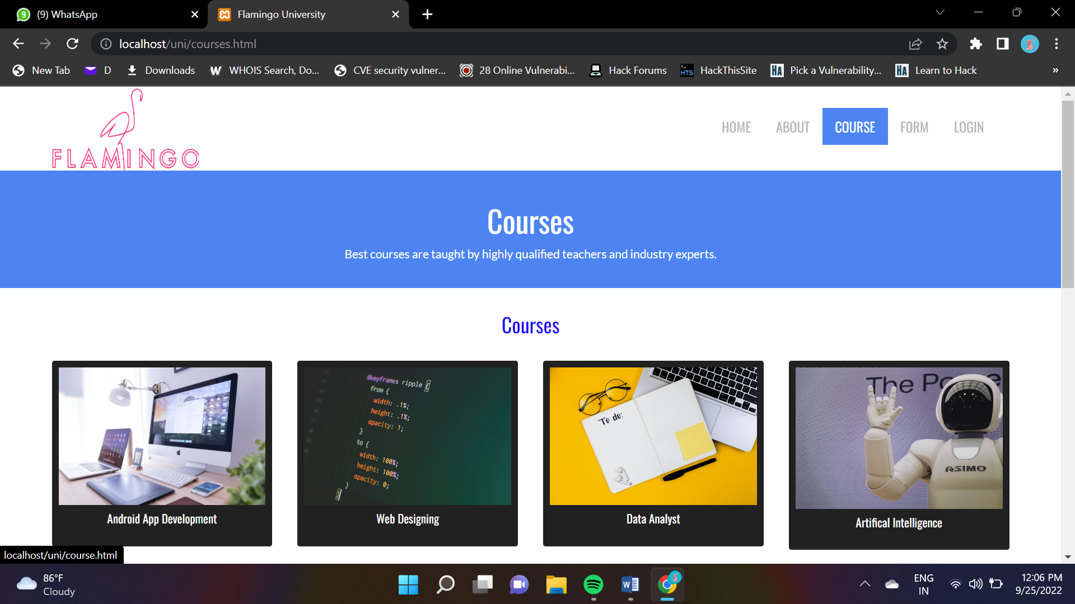
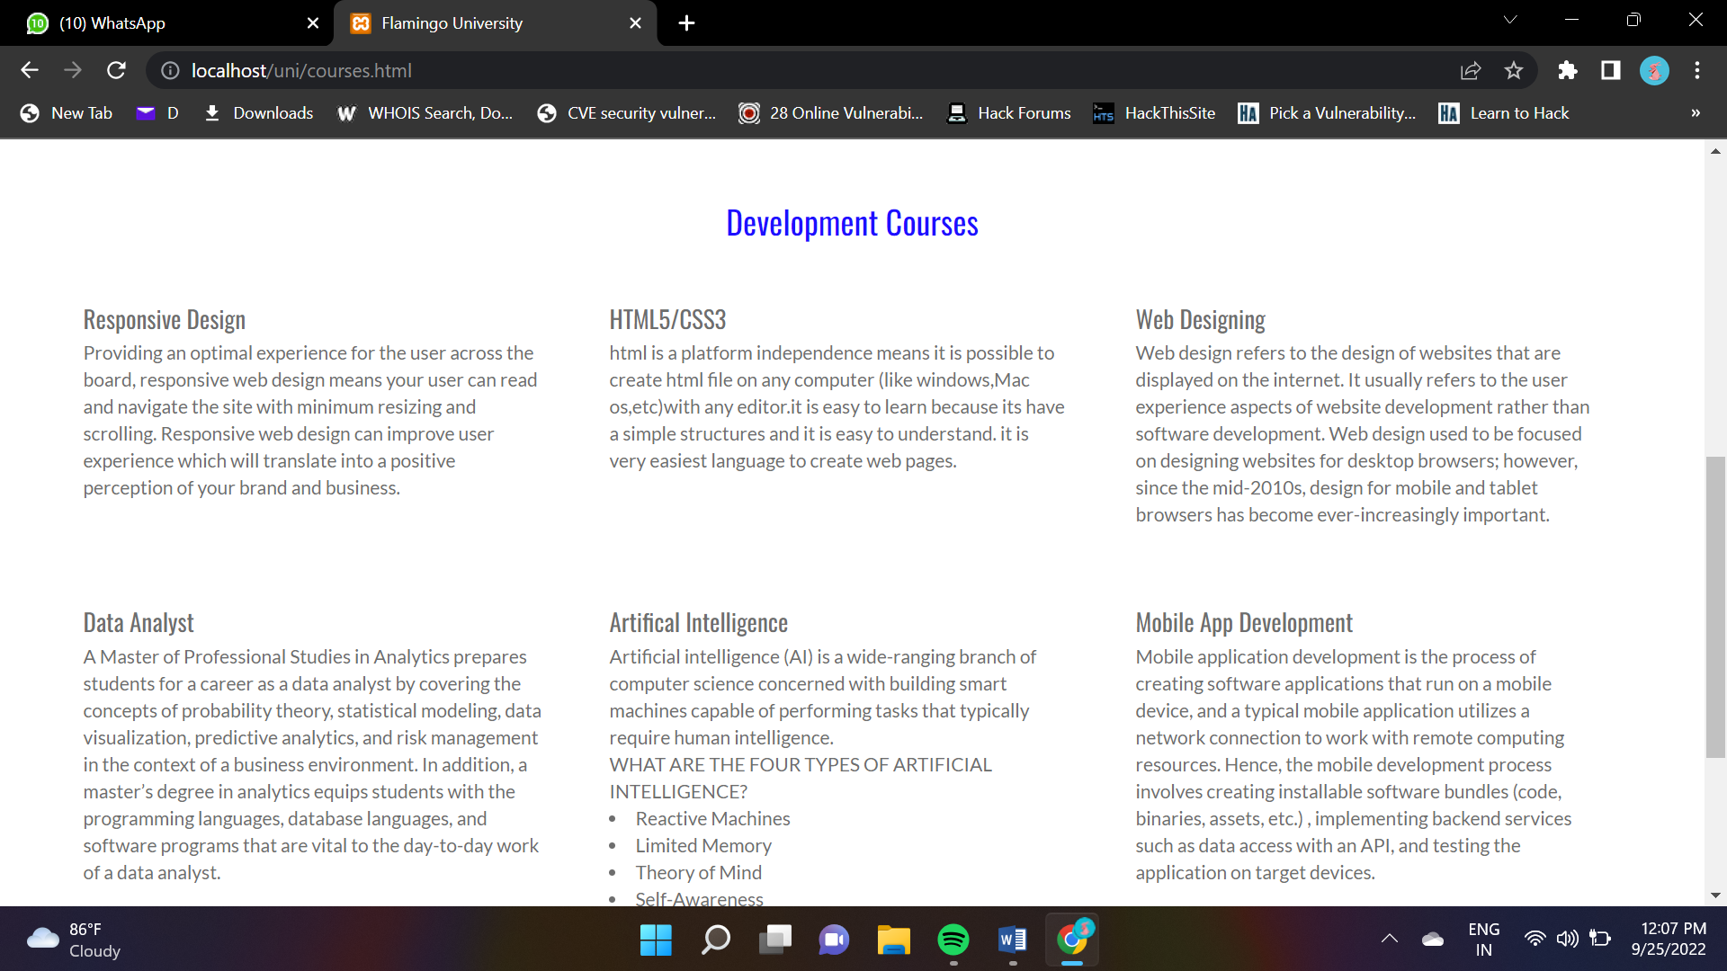
SCREENSHOTS

Slide 20
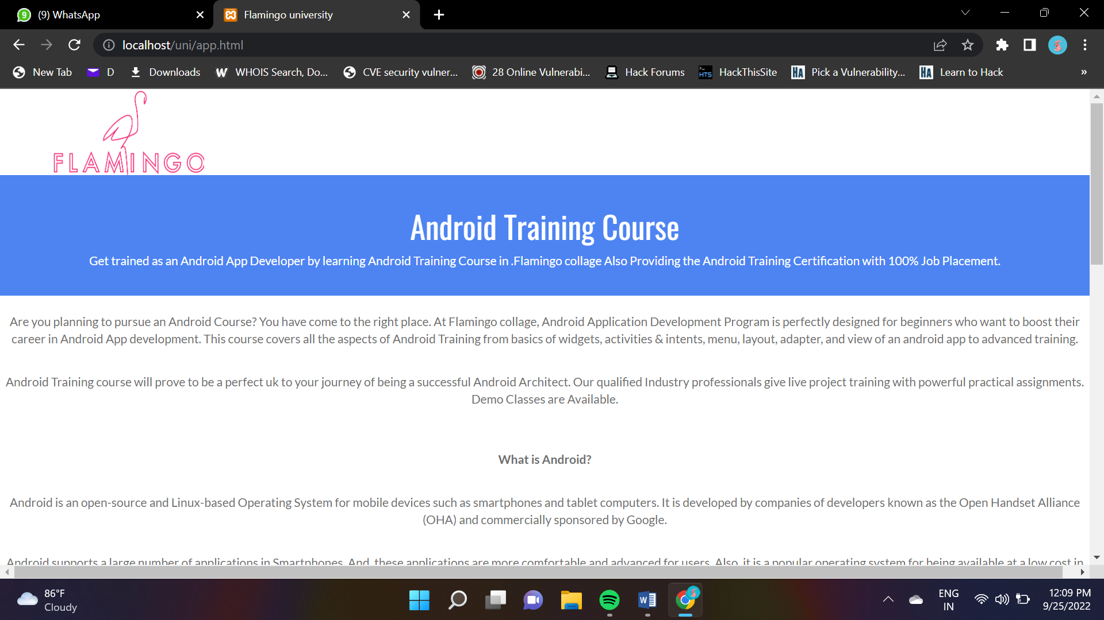
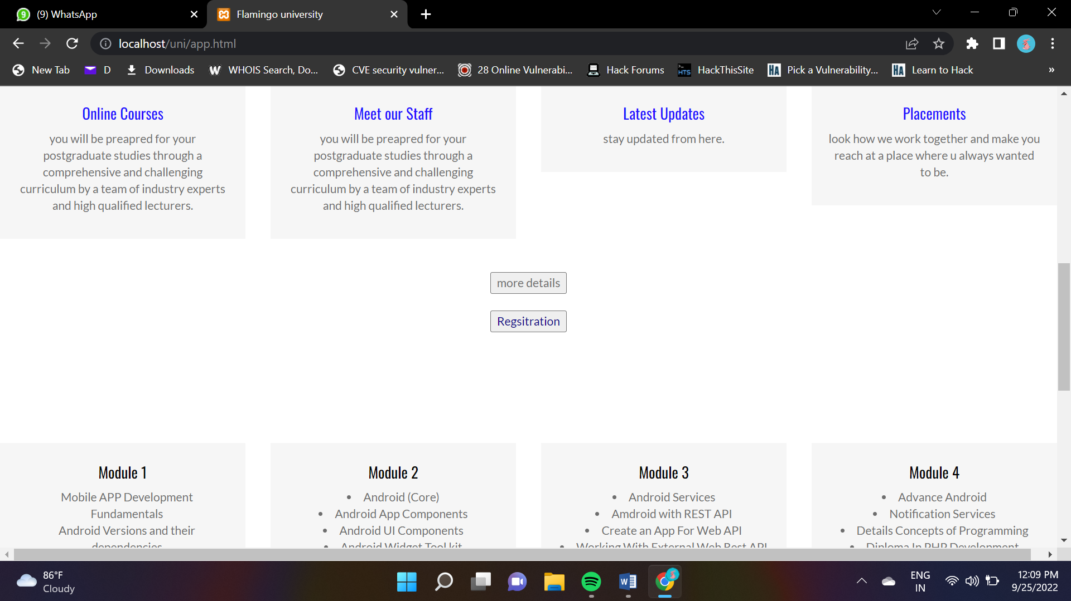
SCREENSHOTS

Slide 21
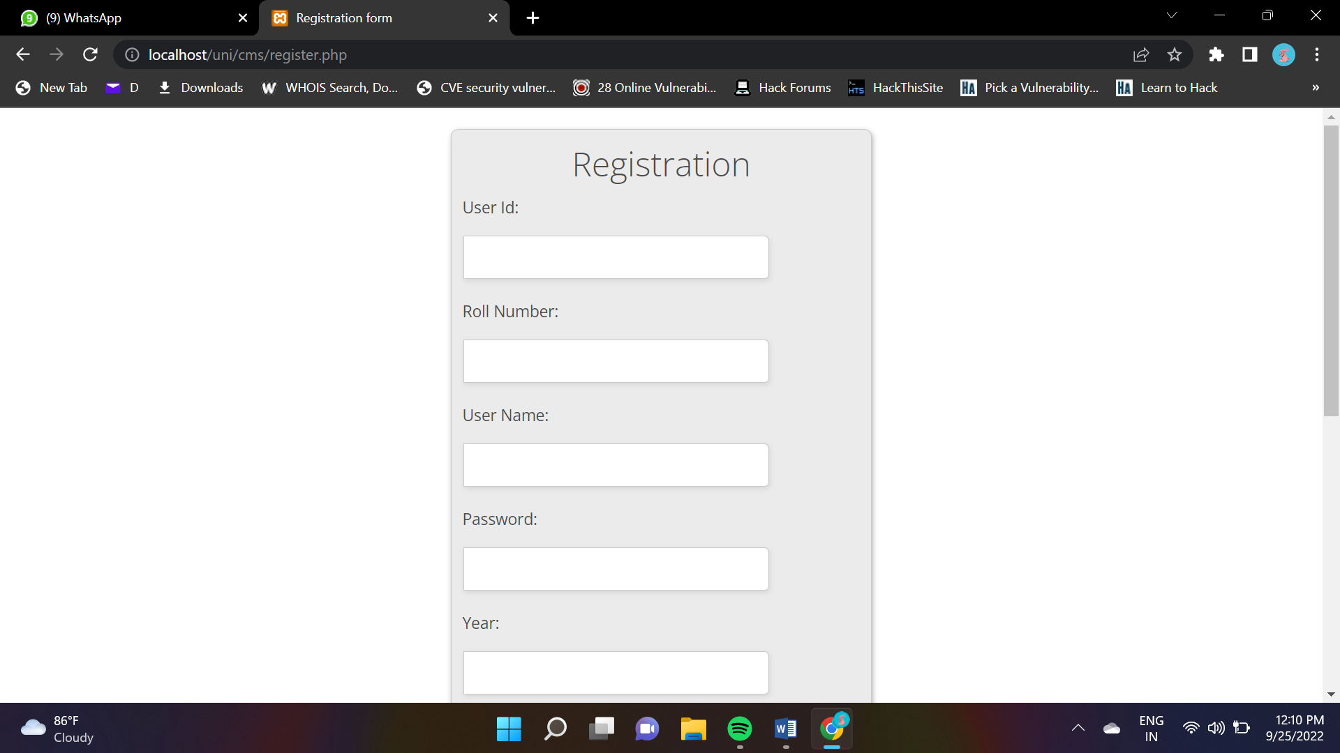
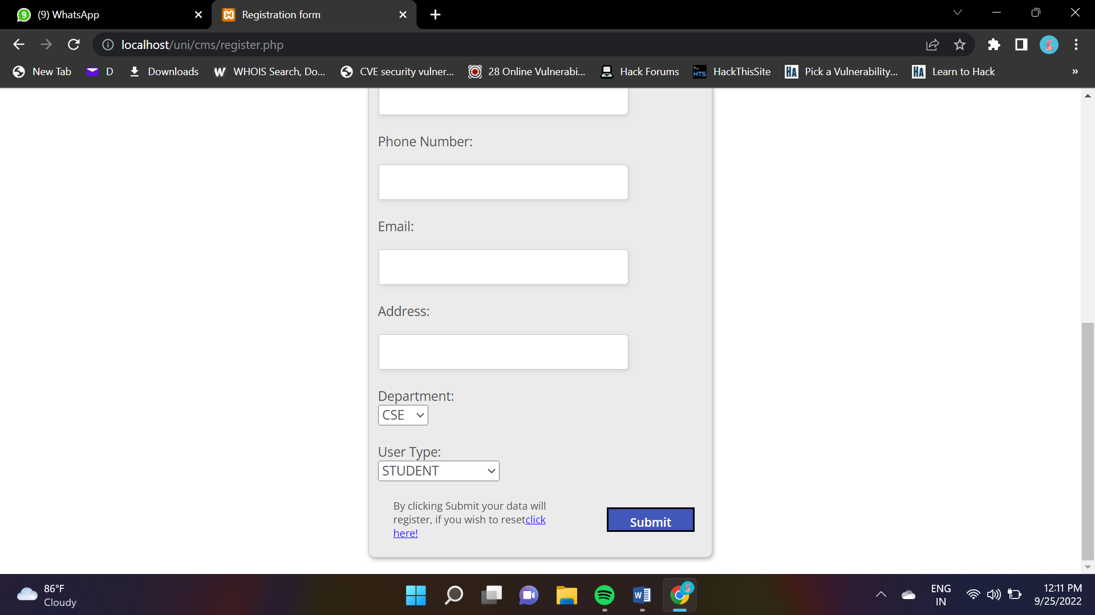
SCREENSHOTS

Slide 22
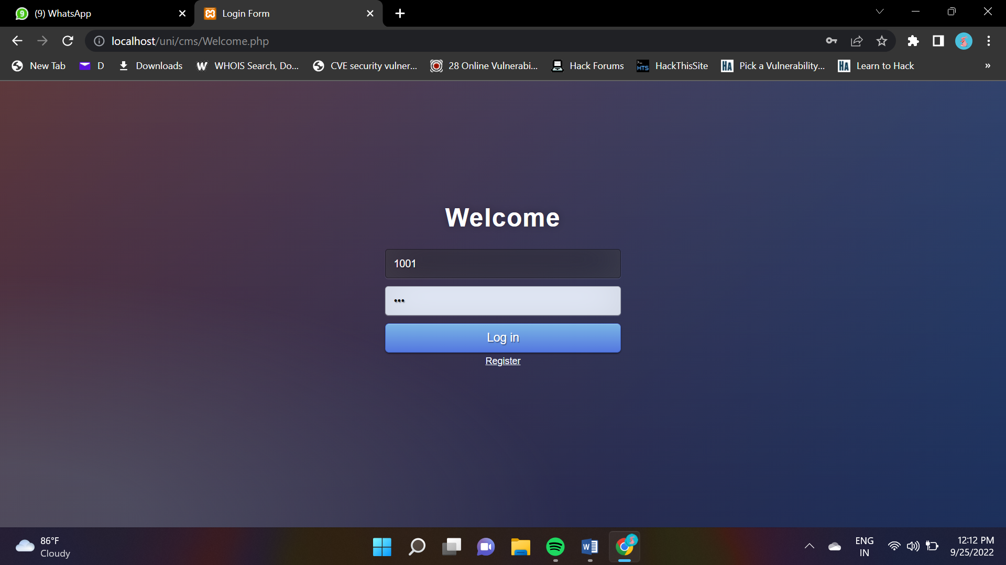
SCREENSHOTS

Slide 23
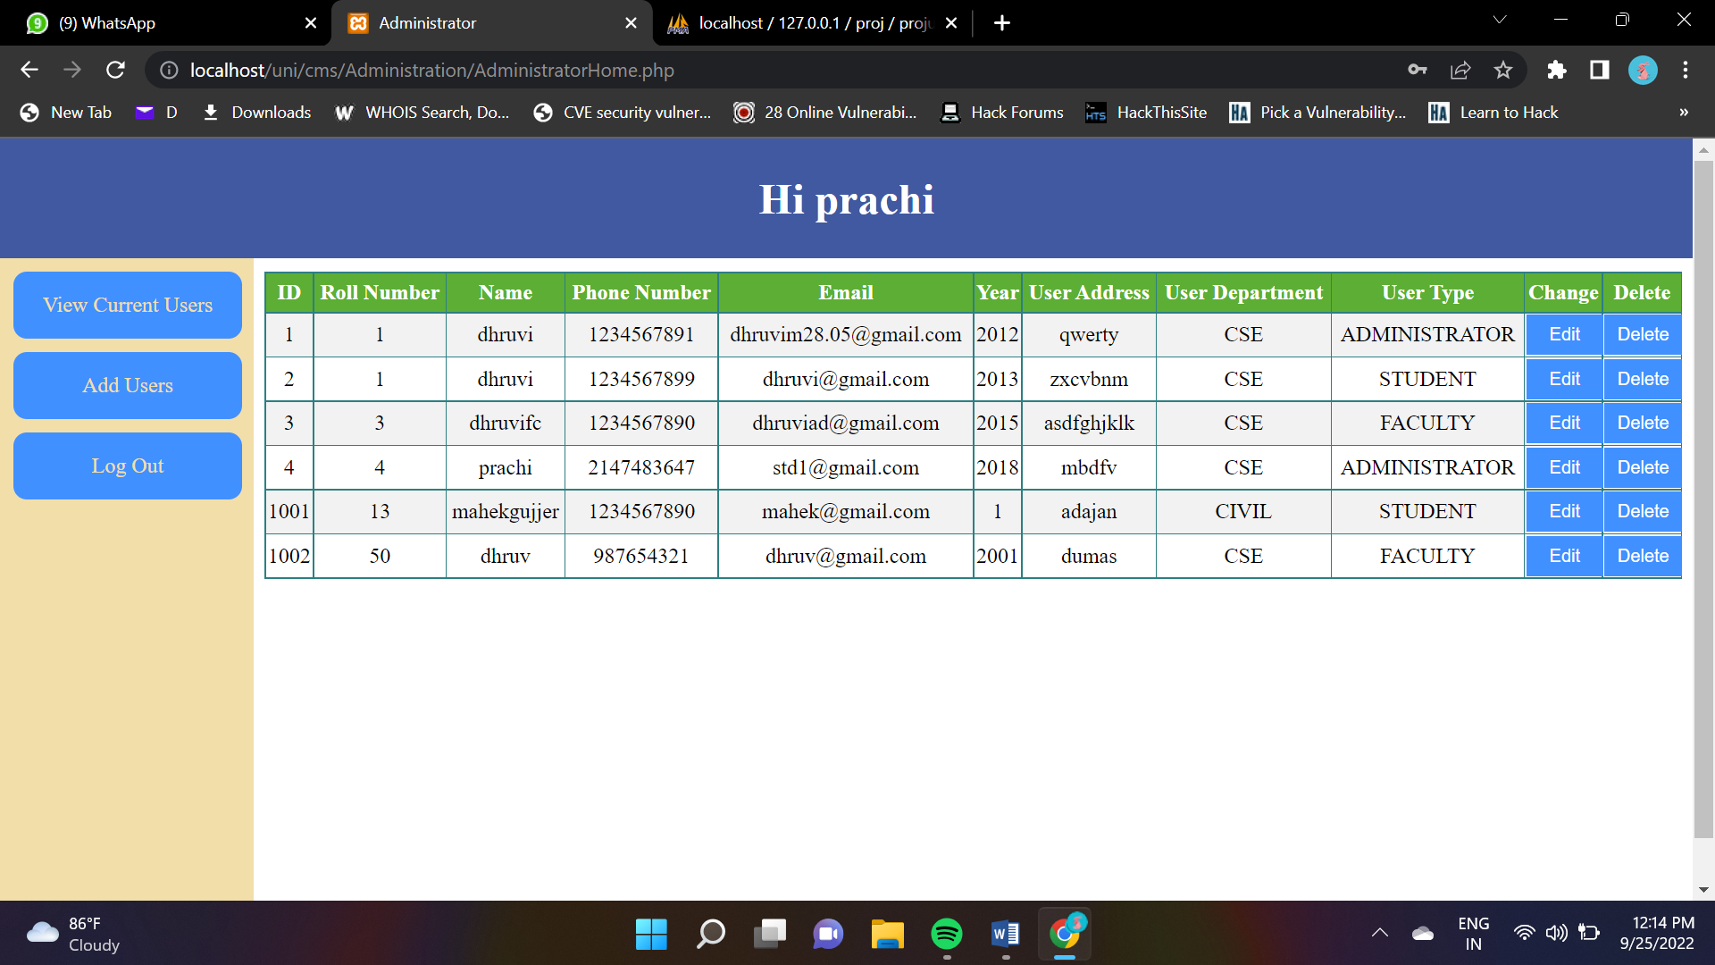
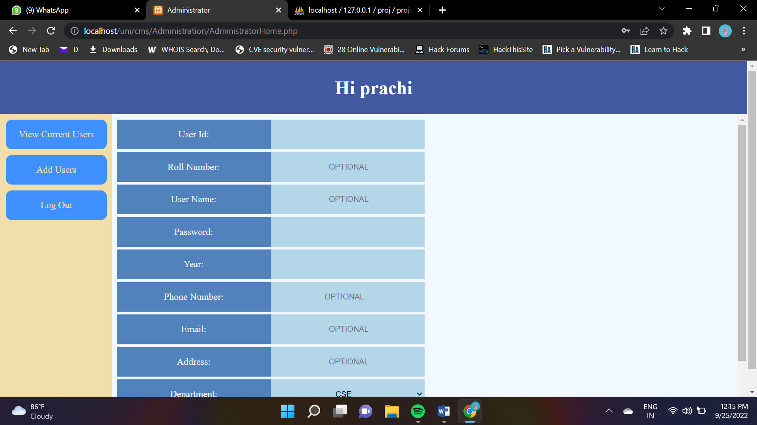
SCREENSHOTS

Slide 24
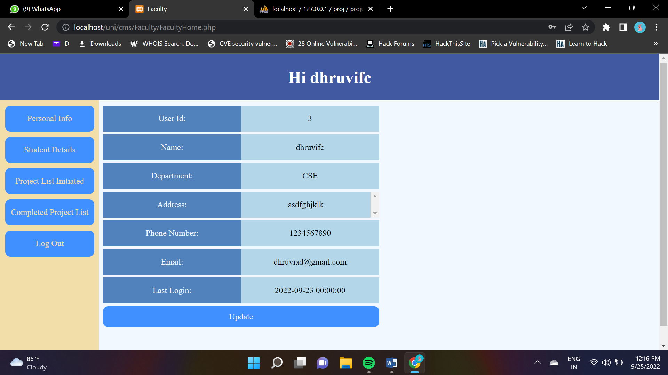
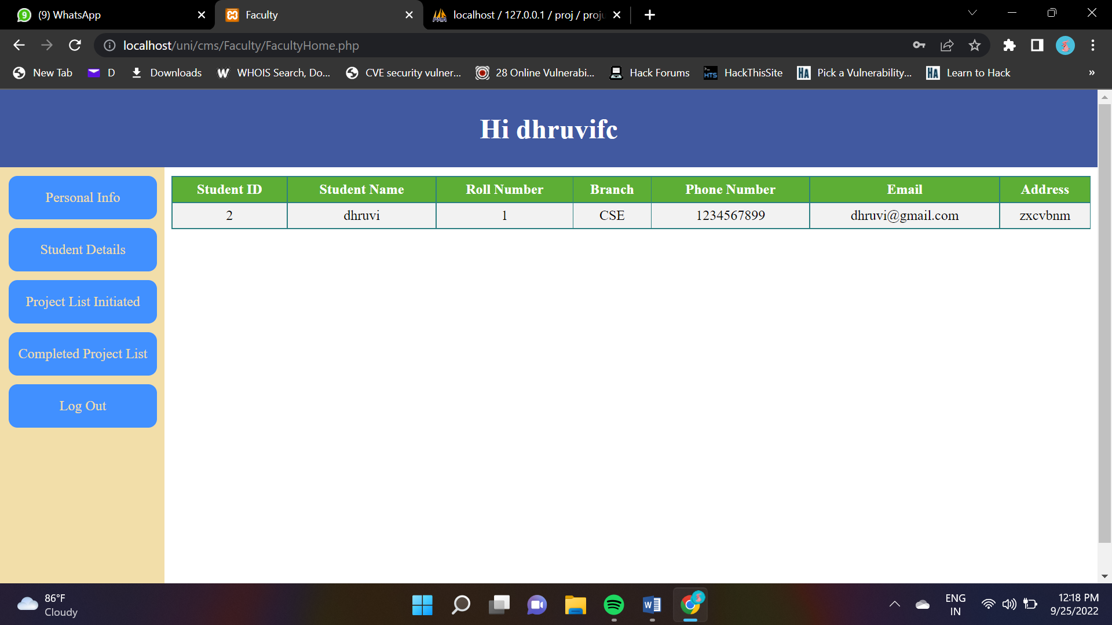
SCREENSHOTS

Slide 25
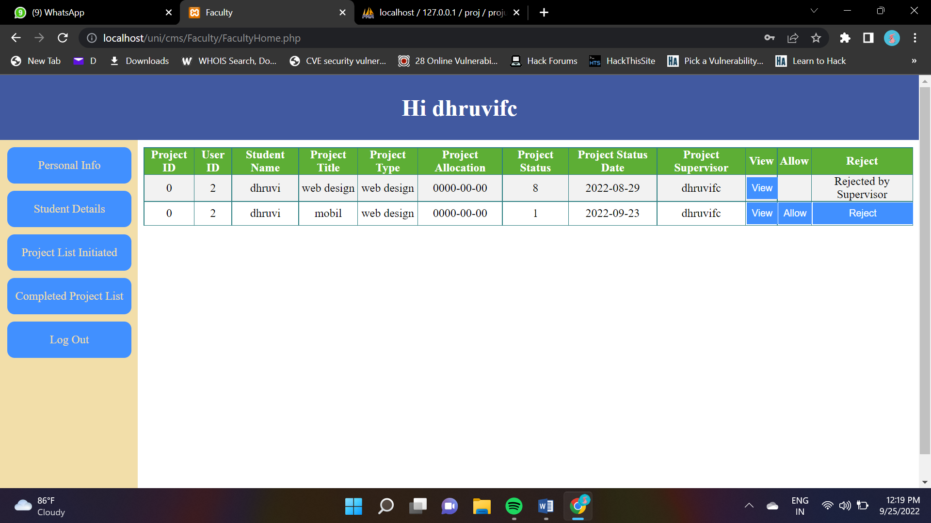
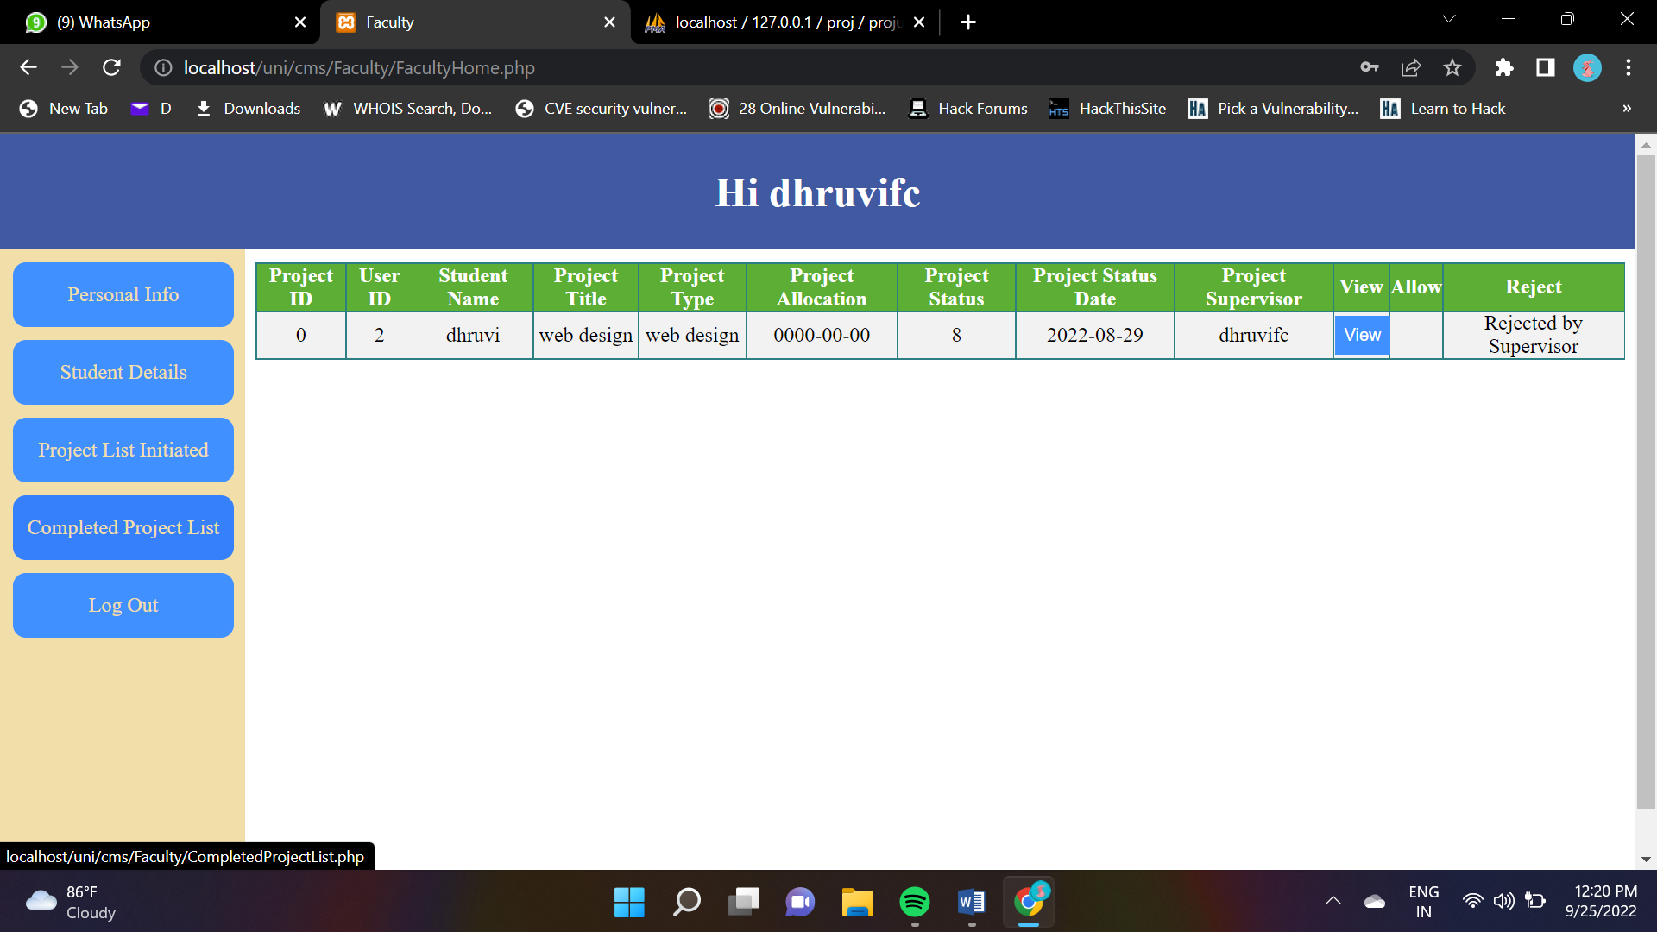
SCREENSHOTS

Slide 26
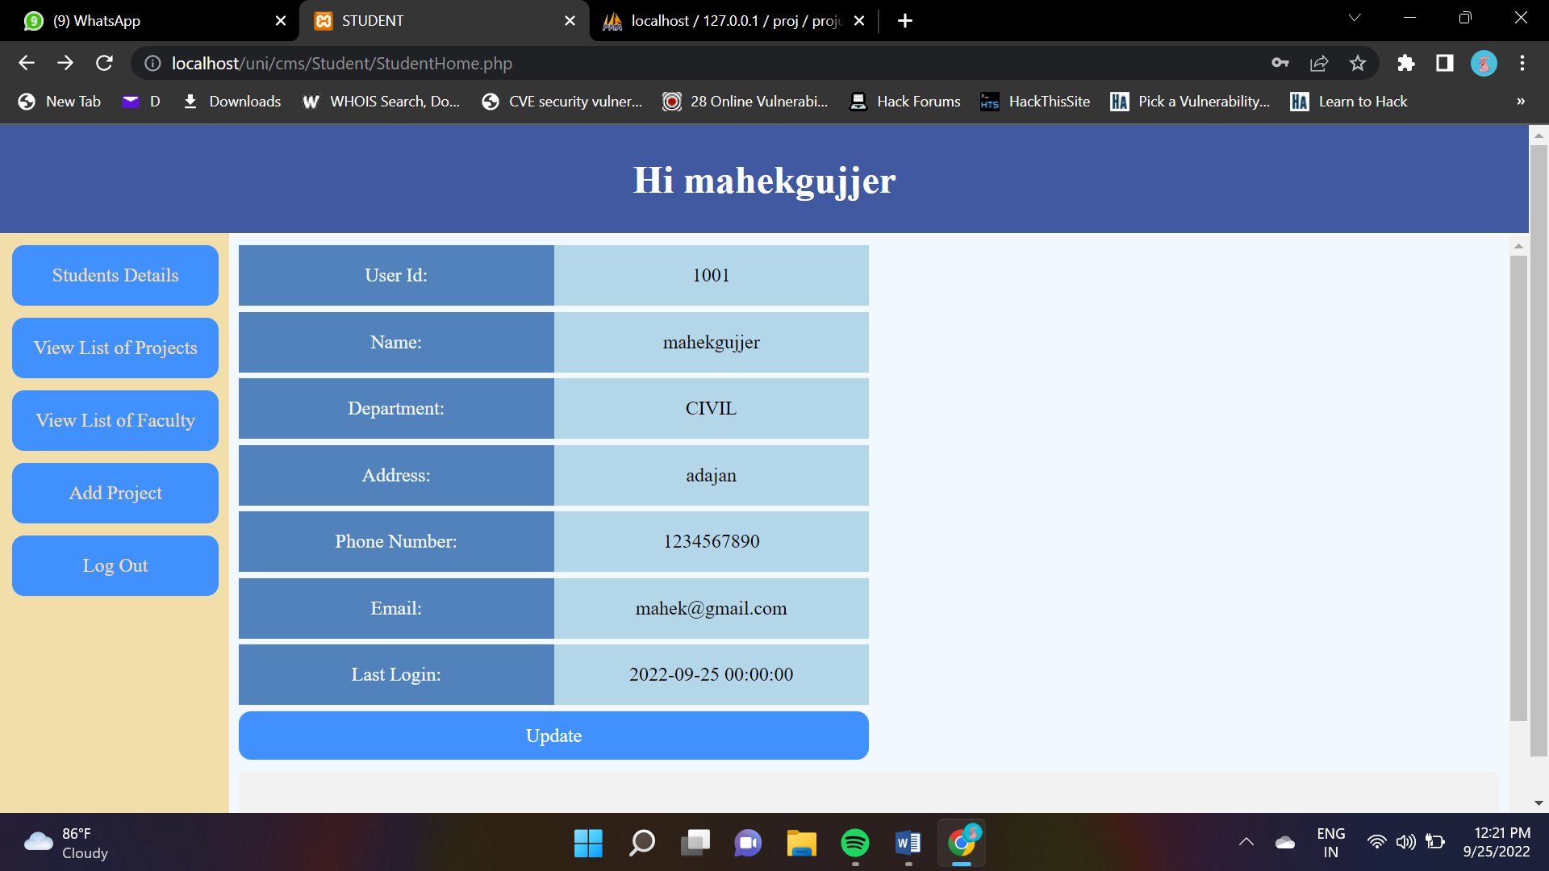
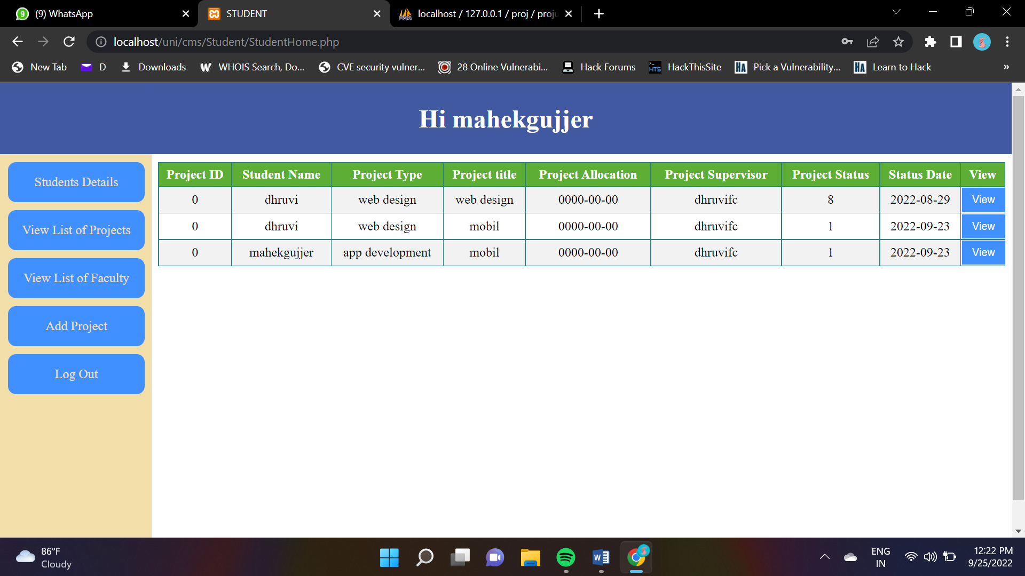
SCREENSHOTS

Slide 27
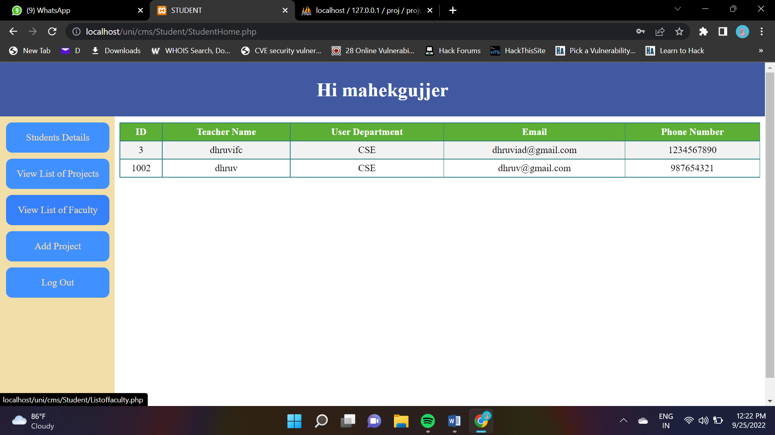
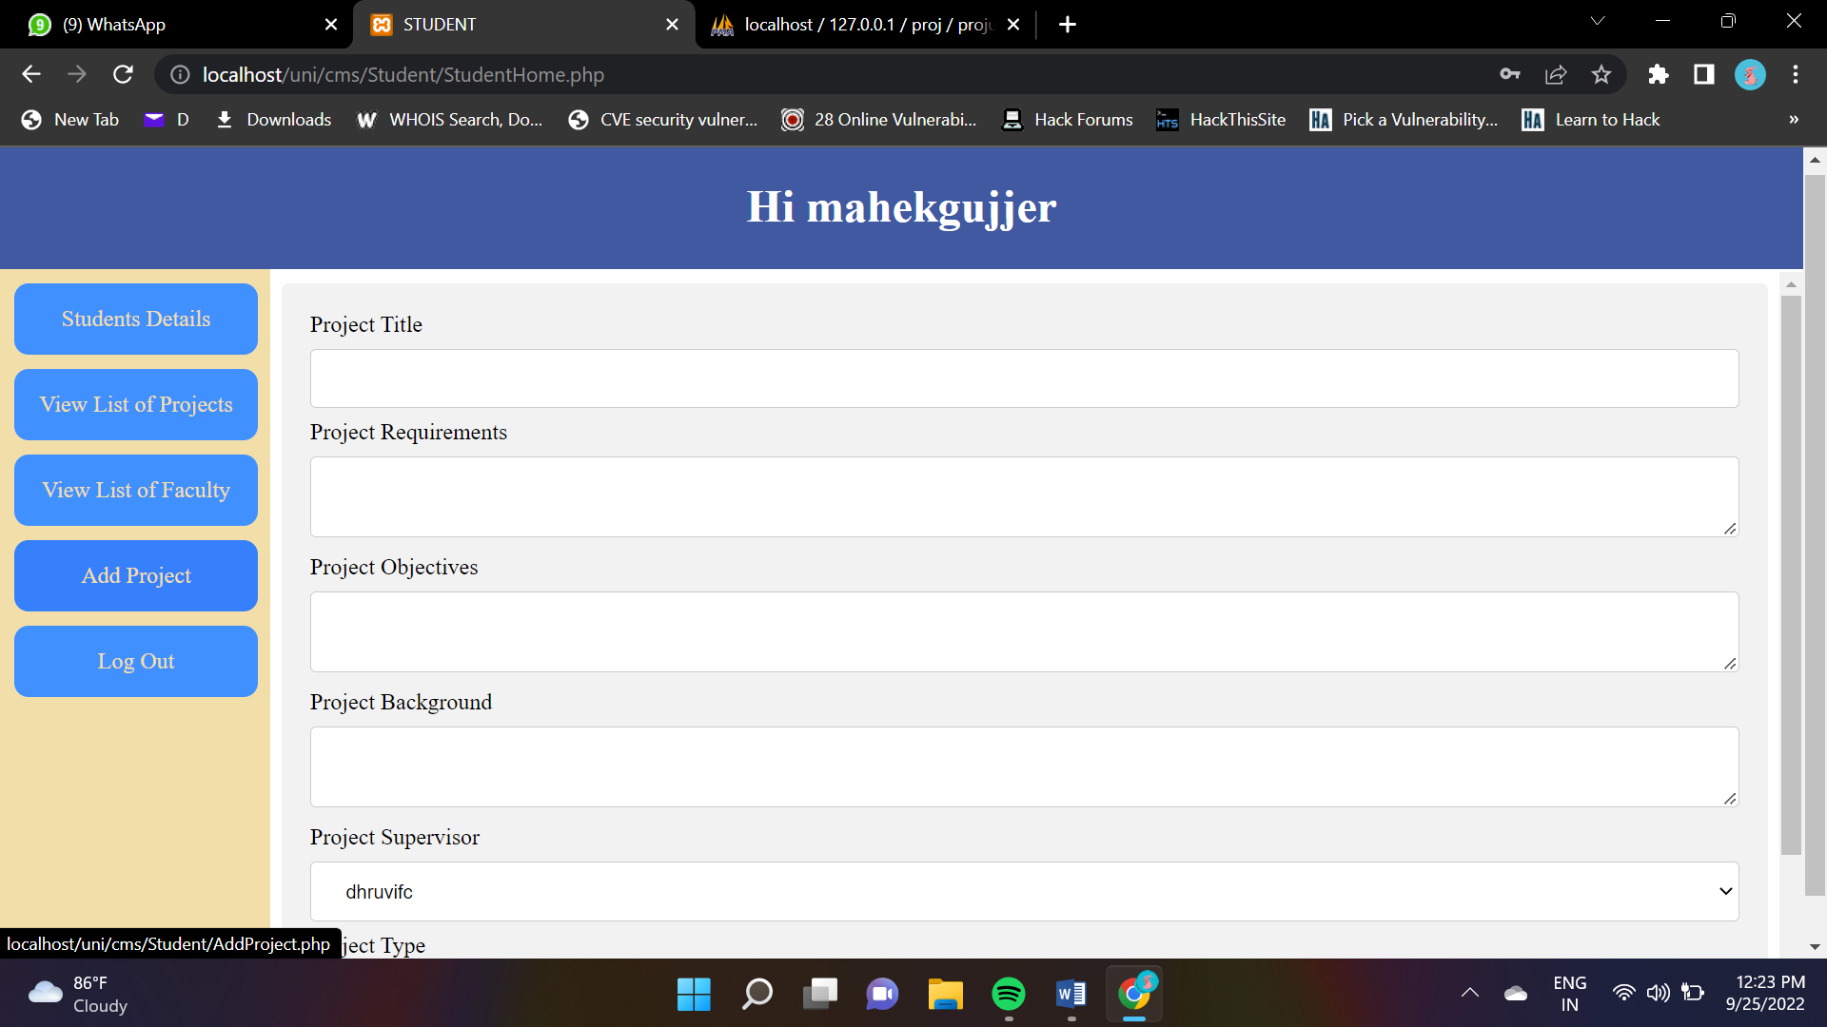
SCREENSHOTS

